Slide 1
Unit : 3
Transmission Media
Prepared By:
Lecturer, AVPTI, RAJKOT

Slide 2
COURSE OUTCOME (CO3)
After the completion of this unit, students will be able to…. Illustrate use of transmission media used in computer network.

Slide 3
LEARNING OUTCOME
After the completion of this session, students will be able to…. list out guided and unguided transmission media

Slide 4
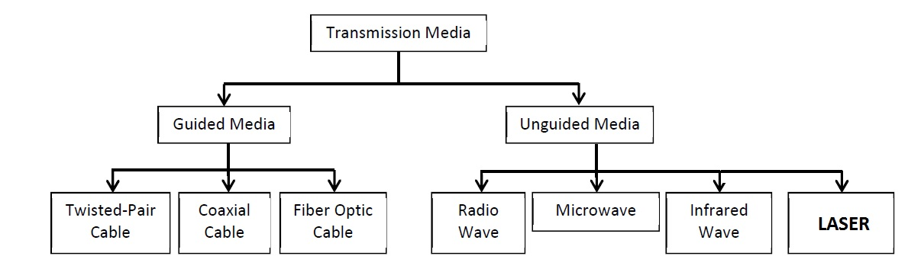
3.1 Types of Transmission Media
Transmission media is the way through which the data, information or messages can flow between the nodes/workstations/computers. OR
A transmission media can be defined as anything that can carry information from a source to a destination. It should be air, water, cable etc.
Transmission media can be classified in to two broad categories: Guided media and Unguided media.
wireless
wired

Slide 5
LEARNING OUTCOME
After the completion of this session, students will be able to…. select appropriate guided transmission media for given network.

Slide 6
3.2 Guided Media (Physical media)
Transmission Media uses a "cabling" system that guides the data signals along a specific path.
It provides a conduit from one device to another
It is also known as ‘bounded media’ or ‘wired communication’.
Examples of guided media are: twisted-pair cable, coaxial cable, and fiber-optic cable.
Twisted pair cable
Twisted pair cable comes into two forms → unshielded and shielded twisted pair.
Both of these types uses
metallic (copper) conductor
that accept and transport
signals in the form of electric current.

Slide 7
Effect of Noise on Parallel Lines (Extra)

Slide 8
Noise on Twisted-Pair Lines (Extra)

Slide 9
Unshielded twisted pair cable (UTP)
  It is most common type of medium used now a days.
It is mostly used in telephone system.
It’s frequency range is suitable for both data and voice.
Frequency range is 100 hz to 5mhz.

Slide 10
Advantages of UTP
  Low cost
  Easy to use
  Cheap and flexible
  Easy to install
  Used in many LAN technology like Ethernet and token ring
Disadvantages of UTP
It can be affected by EMI (electromagnetic interference) which can create noise and damage the signal.
Electronics Industries Association (EIA) has categorized UTP by quality are:
Category 1
  Used in telephone system
  Law speed data communication
Category 2
  Suitable for voice and data up to 4 mbps
Notes:
Atul

Slide 11
Category 3
  It can be used for data transmission up to 10mbps.
  It is now used in standard telephone system.
Category 4
  It can be used for data transmission up to 16mbps.
Category 5
  It can be used for data transmission up to 100mbps.
UTP Connectors
UTP is most commonly connected to network devices via a type of snap in plug like that used with telephone jacks.
Connectors are either male (the plug) or female (the receptive).
Each wire in a cable is attached to one conductor (or pin) in the connector.
The most frequently use of these plugs is an RJ45 (Registered Jack), connector with 8 conductor or RJ11 connector with 4 conductor (see figure).
Notes:
Atul

Slide 12
RJ11 connector with 4 conductor, used in telephone system
RJ45 connector with 8 conductor, used in networking
Notes:
Atul

Slide 13
Shielded twisted pair cable (STP)
  STP cable has a metal foil or braided-mesh covering that encases each pair of insulated conductors, which are a higher quality and more protective jacket than UTP has.
  This gives STP excellent insulation to protect the transmitted data from outside interference (Noise).
  It is less susceptible to electrical interference and supports higher transmission rates over longer distance than UTP.
Notes:
Atul

Slide 14
  It has also a drawback that it is more expensive than UTP.
  STP connector
  STP uses the same connectors as UTP but the shield must be connected to ground.

Slide 15
Coaxial cable
  This cable has better shielding than twisted pair, so it can span longer distance at higher speed.
  As we can see in the figure, it has central core conductor of solid or standard wire (usually copper) enclosed in an insulating sheath, which is in turn encased in an outer conductor of metal foil, braid or combination of two.
Notes:
Atul

Slide 16
  The outer metallic wrapping serves both as a shield against noise and as the second conductor, which completes the circuit.
  Advantages of coaxial cable
  It is most widely used in network cable
  It is relatively inexpensive, light, flexible and easy to work with.
  Installation is very easy.
  It is good choice for longer distance and for reliably supporting higher data rates.
  There are two types of coaxial cable
  Thin (Thinnet)
  Thick (Thicknet)
  Thinnet coaxial cable
  It is a flexible coaxial cable about 0.25 inches thick.
  Easy to install and work with it.
Notes:
Atul

Slide 17
  it can be used in almost any type of network installation almost in BUS topology.
  can carry a signal up to approximately 185 meters (about 607ft) before the signal starts to suffer from attenuation.
  It is referred to the RG-58 (radio grade) family and has 50 - ohm impedance.
  Commonly used for digital transmission.
  Thicknet coaxial cable
  Thicknet is relatively rigid coaxial cable about 0.5 inches in diameter (Almost Double of thin net coaxial cable).
  Thick net can carry signal for 500 meters [about 1640 ft].
  Because of thicknet's ability to support data transfer over longer distance it is sometimes used as backbone to connect several smaller thinnet based networks.
Notes:
Atul

Slide 18
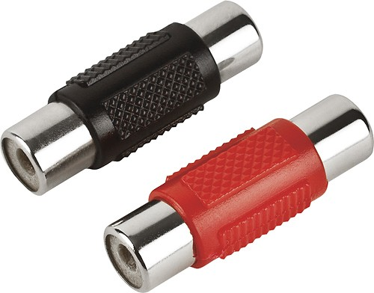
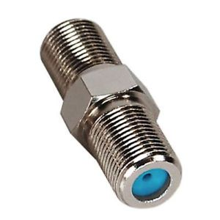
  A device called a transceiver connects the thinnet coaxial to the larger thicknet coaxial cable.
  RG-8, RG-9 and RG-11 used for thicknet coaxial cable.
  Coaxial cable connectors
  There are four types of coaxial cable connectors
  Barrel connectors
  BNC (bayonet network connector)
  T-connectors
  Terminators
Barrel connectors
Notes:
Atul

Slide 19
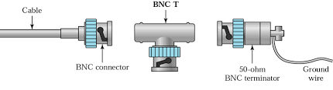
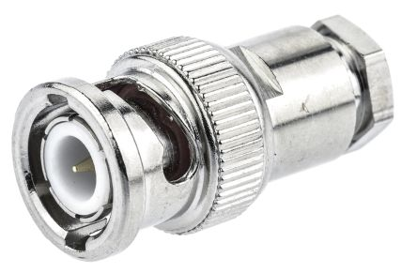
  It is the most common connector.
  Generally this connector is used to connect BNC coaxial cable to increase the length of network.
BNC connectors
After the Barrel connector, the most popular is the BNC, which pushes on and locks in to place with a half turn as shown in fig.
Generally, a cable terminates in a male connector that plugs or screws on to a corresponding female connector attached to the device.
Generally used in cable TV and VCR hook-ups.
Notes:
Atul

Slide 20
  These connectors are used to connect RG-58 or RG-62 with the NIC.
  And these are generally used in BUS and STAR topology.
  T - connectors
  T-Connectors (used in thin Ethernet) allow a secondary cable or cables to branch off from a main line.
  It is also used to extend the network or increase the number of node at any point in the network.
Notes:
Atul

Slide 21
  Terminators
  Terminators are required for bus topologies where one main cable acts as a backbone with branches to several devices but does not itself terminate in a device.
  If the main cable is left non terminated any signal transmitted over the line echoes. A terminator absorbs the wave at the end eliminates echo-back.
  It is used to prevent the signal disturbance.
Notes:
Atul

Slide 22
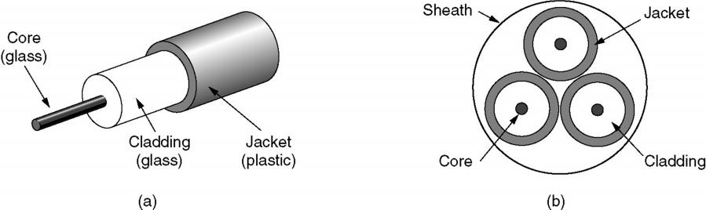
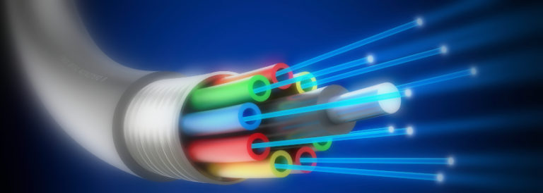
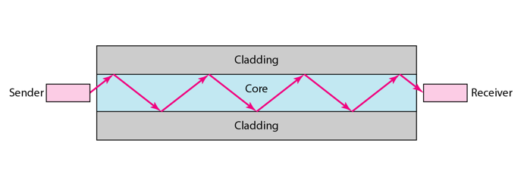
Fiber Optic Cable (FOC)
  Fiber optic cables are similar to coax, except without the braid.
  A fiber-optic cable is made of glass or plastic and transmits signals in the form of light.
Side view of FOC
End view of FOC
Notes:
Atul, fig from net

Slide 23
  Optical fibers use reflection to guide light to move through a channel.
  As we can see in figure, a glass or plastic core is surrounded by a cladding of less dense glass or plastic.
Figure shows a single fiber viewed from the side. At the centre is the glass core through which the light propagates.
The core is surrounded by a glass cladding with a lower index of refraction than the core, to keep all the light in the core.
Next comes a thin plastic jacket to protect the cladding. Fibers are typically grouped in bundles, protected by an outer sheath (ચુસ્ત આવરણ). (that we can see in FOC figure b)
Generally FOC comes in two types: Single mode and Multi mode. In single mode fibers → the core is about 8 to 10 microns and in multi mode fibers → the core is about 50 microns.
(નોંધ: હવે પછીની 7 slides ફક્ત તમારી સમજણ માટે છે.)
Notes:
Atul

Slide 24

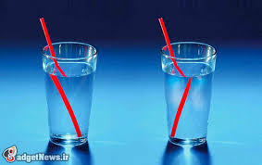
Concept of REFRACTION

Slide 25
Refraction

Slide 26
Critical Angle

Slide 27
Reflection

Slide 28
Multimode Step-Index

Slide 29
Multimode Graded-Index

Slide 30
Single Mode

Slide 31
Advantages of FOC
Higher bandwidth: It can support dramatically higher bandwidths.
Light weight: Fiber-optic cables are much lighters than copper cables.
Longer Distance: in it, optical cables are capable of providing low power loss, which enables signals can be transmitted to a longer distance than copper cables.
Faster speed: speed of data transmission is much higher in it.
Excellent Security: it provides excellent security because they do not leak light and it is quite difficult to tap (વચ્ચેથી સ્ંદેશો સાંભળવો).
Noise Resistance: because fiber optic transmission uses light rather than electricity, noise is not damaging the signal.
Notes:
Atul

Slide 32
Better reliability: FOC is immune (મુક્ત) to temperature changes, severe weather and moisture and it’s not bothered about electromagnetic interference (EMI) which can interrupt the data.
Disadvantages of FOC
Difficult to install: special skills are required to install and maintain fiber optic cables.
Higher cost: it is expensive compare to other cables.
Unidirectional (one direction): propagation of light is unidirectional. If we need bidirectional communication then two fibers are needed.
Fragility: it is made up with glass, so is can be easily broken and it is less useful for application where portability required.
Notes:
Atul

Slide 33
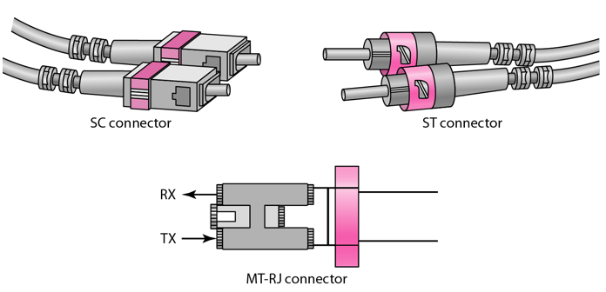
Fiber optic connectors
Fiber optic cables use three different connectors as shown in above figure.
The subscriber channel (SC): connector is used for cable TV. It uses a push/pull locking system.
The straight-tip (ST): connector is used for connecting cable to networking devices.
MT-RJ (Mechanical Transfer Registered jack): is a new connector with same size as RJ45
Notes:
Atul, fig frm Net

Slide 34
Fiber optic communication
Fiber-optic communication is a method of transmitting information from one place to another by sending pulses of light through an optical fiber.
There are three main basic elements of fiber optic communication system.
Light source
Two components are used as light sources: light emitting diodes (LED’s) and LASER diodes, in which LEDs are used for short distances and low data rate applications and LASER is used for longer distances and high data rate transmission.
Optical fiber as a medium
For data transmission, ultra thin optical fiber cable is used.
Photo detector
The purpose of photo detectors is to convert the light signal back to an electrical signal. Two types of photo detectors are mainly used for optical receiver in optical communication system: PN photo diode and avalanche photo diode.
Notes:
Net

Slide 35
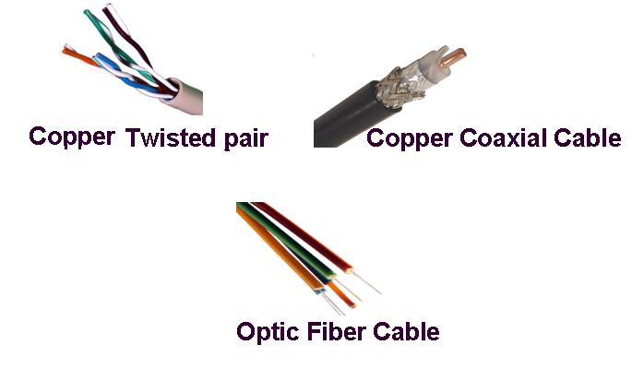
(Just for information)
Notes:
Net

Slide 36
Most common types of Ethernet cabling
Name | Cable | Max Segment | Nodes | Advantages
10Base2 | Thin Coax | 185 m | 30 | No hub needed
10Base5 | Thick Coax | 500 m | 100 | Original cable, now obsolete
10BaseT | Twisted pair | 100 m | 1024 | Cheapest system
10BaseF | Fiber optics | 2000 m | 1024 | Best between buildings
Notes:
Atul

Slide 37
LEARNING OUTCOME
After the completion of this session, students will be able to…. select appropriate unguided transmission media for given network.

Slide 38
3.3 Un guided media
Unguided media transport electromagnetic waves without using a physical conductor.
In it, signals are normally broadcast through air and thus are available to anyone who has a device capable of receiving them.
This type of communication is often referred to as wireless communication.
In some situations where it is impossible to use cables, unguided media are good alternatives.
Electromagnetic spectrum for unguided media is shown below

Slide 39
Signal transmission in unguided media
Sky propagation
Ground propagation
Line-of-sight propagation
Notes:
Net

Slide 40
Signal transmission in unguided media
Unguided signals can travel from source to destination in several ways: ground propagation, sky propagation, and line-of sight propagation.
Ground propagation
In this propagation, radio waves travel through lowest portion of atmosphere, hugging the earth.
These low-frequency signals emanate (માંથી પસાર થવુ) in all directions from the transmitting antenna and follow the curvature of planet.
Distance depends on the amount of power in the signal: greater the power, the greater the distance.
Sky Propagation
In this propagation, higher-frequency radio waves radiate upward into the ionosphere (the layer of atmosphere where particles exist as ions) where they are reflected back to earth.
Notes:
Atul

Slide 41
This type of transmission allows for greater distances with lower power output.
Line of sight Propagation
In this propagation, very high-frequency signals are transmitted in straight lines directly from antenna to antenna.
Antennas must be directional, facing each other and either tall enough or close enough together not to be affected by curvature of earth.
Line-of-sight propagation is tricky because radio transmission cannot be completely focused.
Notes:
Atul

Slide 42
Frequency band for unguided media
Band | Range | Propagation | Application
VLF (very low frequency) | 3 - 30 kHz | Ground | Long-range radio navigation
LF (low frequency) | 30 - 300 kHz | Ground | Radio beacons and navigational locator
MF (middle frequency) | 300 kHz - 3 MHz | Sky | AM radio
HF (high frequency) | 3 - 30 MHz | Sky | Citizens band (CB), Ship / aircraft communication
VHF (very high frequency) | 30 - 300 MHz | Sky and Line-of-sight | VHF TV, FM radio
UHF (ultra high frequency) | 300 MHz - 3 GHz | Line-of-sight | UHFTV, cellular phones, satellite
SHF (super high frequency) | 3 - 30 GHz | Line-of-sight | Satellite communication
EHF (extremely high frequency) | 30 - 300 GHz | Line-of-sight | Radar, satellite
Notes:
Net

Slide 43
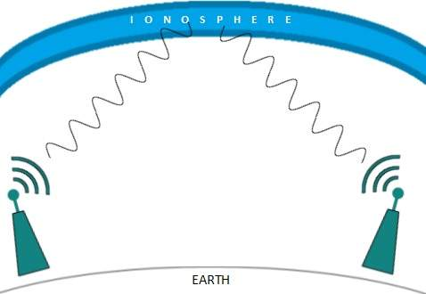
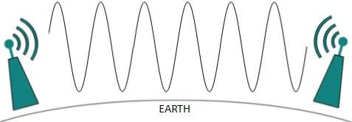
Classification of unguided media
Main three categories are there → 1. Radio wave and Micro wave, 2. Infrared waves and 3. LASER
Radio wave transmission
Radio waves are electromagnetic waves occurring on radio frequency portion of the electromagnetic spectrum.
Notes:
Atul

Slide 44
These electromagnetic waves are ranging in frequency between 3KHz and 1GHz.
A common use is to transport information through the atmosphere or outer space without wires.
Radio waves are Omni directional, means they can travel in all direction from the source. So transmitter and receiver do not have to be aligned physically.
Radio waves are easy to generate, can travel long distance and can penetrate (માંથી પસાર થવું) buildings. So they are widely used for communication in both indoors and outdoors.
Radio waves are of ‘sky propagation’.
Advantages of radio waves
It can travel long distance (for ex. AM radio).
Widely used for communication in both indoors and outdoors.
Radio waves can travel in omni direction, so no need to aligned antennas physically.
Notes:
Atul

Slide 45
Disadvantages of radio waves
Because of omni directional antenna, the signal sent by one antenna can be interfered by another antenna that may be using same frequency or band.
They can penetrate walls, so we can not isolate whether the communication to just inside or outside the building.
Due to the narrow side bands (up to 1GHz), there is low data rate for digital communication.
Applications of radio waves
AM and FM radio
GPS service
Cordless phone
Police radio
Television broadcast.
Notes:
Atul

Slide 46
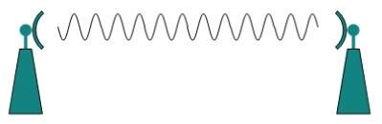
Micro waves transmission
These electromagnetic waves are ranging in frequency between 1GHz and 300GHz.
These waves are unidirectional, means when an antenna transmits microwaves, the sending and receiving antenna need to be aligned. Signals of micro waves are narrowly focused.
Micro waves are of ‘line-of-sight’ propagation.
Notes:
Atul

Slide 47
Advantages of micro waves
There is no interference of another pair of aligned antennas.
As band is wider than radio waves, high data rate for digital communications.
Inexpensive and easy to install.
Disadvantages of micro waves
These waves are unidirectional, so sending and receiving antennas must be aligned.
Repeaters are required for longer distance.
Very high frequency waves can not penetrate the walls, so receivers inside the buildings can not communicate.
Applications of micro waves
These waves are used for unicasting (one sender and one receiver).
Cellular phones
Satellite networks
Wireless LANs
Notes:
Atul

Slide 48
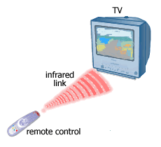
Infrared waves transmission
These electromagnetic waves are ranging in frequency between 300GHz and 400THz.
These waves are used for short range communication.
Examples of infrared are → remote controls used on televisions, VCRs, and stereos.
Infrared waves are of ‘line-of-sight propagation’.
Notes:
Atul

Slide 49
Advantages of infrared waves
Infrared waves are relatively directional, cheap, and easy to build.
Infrared waves having high frequency, so they are not able to penetrate the walls, so in a room infrared systems can’t be interfered.
Infrared waves are useful for short range communication. It is more secure against taping.
Disadvantages of infrared waves
These waves are useless for long range communication.
They do not pass through solid objects.
Sun’s ray can interfere the radio waves, so it is not good to use infrared outside the buildings.
Notes:
Atul

Slide 50
Applications of infrared waves
Used in short range wireless communication devices (e.g. Wireless mouse or keyboard).
Used in remote controls of TV, VCRs and stereos based on infrared.
Used in thermal efficiency analysis, remote temperature sensing, weather forecasting.
Also used in military applications: target acquisition, surveillance, tracking.
Notes:
Atul

Slide 51
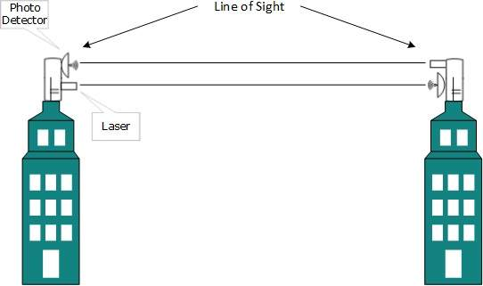
LASER transmission
The full form of LASER is → Light Amplification Stimulated Emission of Radiation.
Laser beams are unidirectional, therefore this type of transmission system use ‘line-of-sight’ propagation. So sender and receiver must be aligned
It is similar to infrared technology but can transmit signal to long distance.
Notes:
Atul and Fig frm Net

Slide 52
Lasers cannot penetrate obstacles such as walls, rain, and thick fog. Additionally, laser beam is distorted by wind, atmosphere temperature, or variation in temperature in the path.
In such a transmission system, a photo detector and laser is set on both sender and receiver side.
The carrier used for the transmission signal is typically generated by laser diode.
Advantages of laser
Laser is safe for data transmission as it is very difficult to tap 1mm wide laser without interrupting the communication channel.
It offers very high band width at a very low cost.
It is free from electro-magnetic interference. This phenomenon is used in optical wireless communication through free space for telecommunication as well as computer networking
High speed.
It has very minimum signal leakage.
Notes:
Frm net

Slide 53
Higher data storage is possible because single laser beam can be focused in areas smaller than 1 micro diameter.
Disadvantages of laser
Maintenance is costly and difficult.
It is harmful to human beings and often burns them during contacts.
Applications of laser
Laser communications have been utilized for mass communications including telephone conversations and even television channels.
Used in digital data transmission.
Effectively used for shorter distance communication.
Notes:
Atul

Slide 54
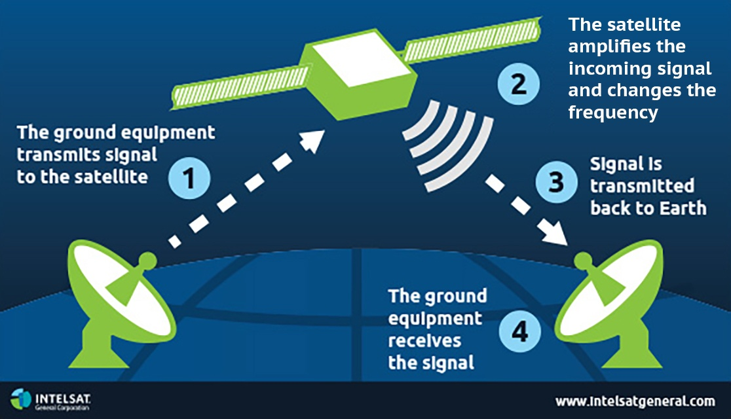
Satellite communication
Notes:
Atul

Slide 55
The satellite is man made equipment that is placed in orbit around the earth. They provide communication from one point on the Earth to another.
Satellite work as transmitter/receiver that is launched by rocket and placed in orbit.
Satellites enable communication over large distance (beyond line of sight).
Used in communication in ships, aircrafts and other mobile vehicles, weather forecasting, television broadcast, internet communication, radio communications and global positioning system (GPS).
There are two types of communication satellites → ACTIVE and PASSIVE.
Active satellite acts as a repeater, it amplifies the received signals and retransmits them back to earth.
Notes:
Atul

Slide 56
Passive satellite only reflects received radio signals back to earth.
As we have seen in the figure, earth station transmits signals to the satellite using UP-LINK frequency and the satellite then amplifies the signals, covert them and transmit back to the receiving earth station using DOWN-LINK frequency.
Advantages of satellite communication
Mobile communication can be easily established by satellite communication.
It is best communication for long geographical distance where cable communication is impossible.
Effective point-to-multipoint communication.
Signal quality is high compared to fiber optics.
Low operating cost.
Notes:
From net

Slide 57
Disadvantages of satellite communication
Delay in signal transmission.
Efficiency reduced in long file transfer.
Manufacturing of satellites is expensive.
Applications of satellite communication
TV/radio broadcasting and global mobile communication.
Weather forecast, military, navigation
Notes:
From net

Slide 58
Baseband V/S Broadband transmission
Data signals can be sent over a network cable in one of two ways: broadband or baseband.
Baseband
A baseband transmission is carried over a single wire using digital signalling.
Baseband communications are bidirectional. Signals can be both sent and received (but not simultaneously).
Time Division Multiplexing(TDM) allows multiple signals to be sent via baseband transmission on a single cable. TDM allocates the multiple signals across time slots.
Baseband transmissions use the entire media bandwidth for a single (સિંગલ્) channel.
Baseband signaling is used on most Ethernet networks.
Most LANs use baseband signaling.
Notes:
From net

Slide 59
Broadband
Broadband transmission is analog transmissions.
The media used in broadband transmission is split into two channels to allow signals to be both sent and received.
Frequency Division Multiplexing (FDM) is used to create multiple broadband channels.
Broadband transmissions divide the entire media bandwidth into multiple channels.
One good example of broadband signaling would be how you view different channels through your cable box and a single coaxial cable carrying multiple signals in cable television.
Notes:
From net

Slide 60
Thank You…

